Slide 1
Washington Update
Bob Blancato
October 4, 2019
rblancato@matzblancato.com

Slide 3
Recess Is Here… But Then What?
But then returning to DC after Columbus Day to… what?
Impeachment inquiry takes center stage, especially in the House
Key question is whether formal articles filed by end of year?
Also of note: the impact on big ticket items
Particularly prescription drug pricing bills – the process had been moving forward, but what now?

Slide 4
Quick Comparison: Senate vs. House Rx Bills
Senate Finance Bill
Passed Through Committee
House/Pelosi Bill
Introduced
$3,100 cap on out-of-pocket costs of Part D prescription drugs
Inflation rebates: companies would have to repay govt for excessive price increases of Rx drugs (increases over inflation)
International pricing index
Final drug prices negotiated with manufacturers
Inflation rebates
Caps out-of-pocket Part D at $2,000
Reinvests savings into vision/hearing/dental benefits

Slide 5
What Else Is Impacted?
Surprise medical billing
Gun control
In short, we’re in the world of the unknown

Slide 6
FY 2020 Funding

Slide 7
Beyond Impeachment: FY 2020 Funding
Where we stand:
CR has been passed—ensuring uninterrupted funding through November 21
Previously, House passed a good group of funding bills, especially for HHS
As it relates to aging programs—House-passed bill provides some good increases in programs such as nutrition, supportive services, SCSEP
Senate Labor-HHS has been held up by “poison pills” – so the following numbers are proposal-only for Senate

Slide 8
Program | FY19 Final | FY20 House | FY20 Senate
OAA Title IIIB HCBS | $385 million | $422 million | $385 million
OAA Congregate Meals | $495 million | $525 million | $495 million
OAA Home-Delivered Meals | $251 million | $305 million | $251 million
Nutrition Services Incentive Program (NSIP) | $160.1 million | $170 million | $160.1 million
OAA Title IIIC Nutrition Totals | $906.7 million | $1 billion | $906.7 million
OAA Title V SCSEP | $400 million | $463.8 billion | $400 million
OAA VI Native Americans Nutrition | $34.2 million | $37.2 million | $34.2 million
Family Caregiver Support Program | $180.6 million | $200 million | $180.6 million
Senior Corps | $202.1 million | $221.5 million | $202.1 million
Comm. Services Block Grant (CSBG) | $725 million | $760 million | $700 million
Social Services Block Grant | $1.7 billion | $1.7 billion | $1.7 billion
LIHEAP (Home Energy Assistance) | $3.69 billion | $3.84 billion | $3.69 billion
Elder Justice Initiative | $12 million | $17 million | $12 million
SHIP (Medicare Assisters) | $49.1 million | $55 million | $49.1 million
Comm. Develop. Block Grant (CDBG) | $3.3 billion | $3.6 billion | $3.3 billion

Slide 9
Funding (cont.)
Senate Labor-HHS will be complicated to resolve
May get more complicated because of the CR, because you can defer items for now but then face another deadline
Issues like the wall as an example
Our message to Sens. Schumer and Gillibrand: support the House bill or do better!

Slide 10
Older Americans Act Reauthorization

Slide 11
Older Americans Act Reauthorization
The House Education and Labor Committee has passed H.R. 4334, the Dignity in Aging Act, aka the reauthorization of the OAA
Rep. Stefanik co-sponsored the bill
A bipartisan modest 5-year extension of this great Act
Next stop: House floor

Slide 12
What’s New? Important Provisions
35% increase in total authorizations over life of bill
Sends important message to actual funders
Adds malnutrition screening to the act as part of nutrition screening within broader routine health screening of disease prevention and health promotion services
Also adds reducing malnutrition as stated objective of the nutrition program
Brings research, evaluation and demonstration programs back into the Act after a long absence

Slide 13
Important Provisions (cont.)
Establishes an Interagency Coordinating Committee on Age Friendly Communities and tasks this committee with coordinating efforts to promote safe and accessible independent living environments
Provides greater support for family caregivers, including the use of caregiver assessments

Slide 14
Important Provisions (cont.)
Places a greater focus on social isolation by empowering local organizations to evaluate solutions for social isolation and incorporating social isolation screening into health and supportive services
Continues the Falls Prevention and Chronic Disease Self Management programs
And adds social determinants of health to the purposes of Title III

Slide 15
What Stays Put?
Transfer authority between B and C1/C2
Separation of C1 and C2
Voluntary contributions/no cost-sharing in nutrition

Slide 16
Next Steps
Passage by full House
Senate must follow
Have already seen a draft bill in June
Expect introduction soon
Then, work out the differences
So, the Senate is the unknown
Sens. Gillibrand on Aging Committee—urge her to reauthorize the Act before the end of the year

Slide 17
Other Nutrition Work

Slide 18
SNAP Changes
Trump administration has issued a proposed rule to eliminate broad-based categorical eligibility
Less restrictive asset and income tests – NY participates
If you receive SSI, automatically eligible
This proposal would take SNAP benefits away from 660,000 people with seniors in the home – 13.2% of all senior households
Would also raise administrative burden
NANASP, Meals on Wheels America, and dozens of other senior orgs sent in a joint comment
Over 75,000 comments received opposing the rule

Slide 19
Malnutrition: By the Numbers
Up to 50 percent of older adults living in community settings (not in long-term care facilities) may be malnourished
Patients who are malnourished while in the hospital have a greater risk of complications, which is associated with up to a 300 percent increase in costs.
Patients with malnutrition may also experience longer hospital lengths of stays, up by 4 to 6 days
New York spends over $1 billion on disease-associated malnutrition costs every year
Food insecurity contributes to malnutrition—this is why the SNAP changes are so dangerous

Slide 20
Defeat Malnutrition Today Coalition
So, for the past four years, we have been cultivating the Defeat Malnutrition Today coalition
94 member organizations and counting
Just completed a successful Malnutrition Awareness Week observance highlighted by the introduction of Senate Resolution 338, bipartisan legislation co-authored by Sens. Chris Murphy (D-CT) and Charles Grassley (R-IA)
They were joined by Sens. Sinema, Booker, Blumenthal, Capito, Coons, Hassan, King, Roberts, Feinstein, Lankford and Wyden

Slide 21
NANASP-NRCNA Congregate Meals Grant
NANASP partnered with the National Resource Center on Nutrition and Aging for a year-long grant on the future of congregate nutrition programs
Products included:
A day-long convening/conference for 50 participants and staff in March 2019 and a proceedings document (included Marian Lewek of Queens Village, NY)
Two “virtual summits” (interactive webinars) for collecting further feedback from the network
A literature review of the current state of congregate nutrition programs
Three fact sheets on various aspects of the congregate nutrition program
Two conference presentations
A “Leaders Lab” gathering of nutrition network providers to further discuss these topics on quarterly calls

Slide 22
Where to Find the Resources
You can find the proceedings, fact sheets, and literature review at http://futureofcongregate.com
To join the Leaders Lab, email mponder@nanasp.org

Slide 23
New Medicare Advantage Opportunity
In April, CMS issued a final “call letter” for Medicare Advantage for the 2020 plan year
Final call letter provided examples of new supplemental benefits that could be covered for chronically ill, including:
“meals furnished to the enrollee beyond a limited basis, transportation for non-medical needs… and benefits to address social needs”
Also includes meals provided in a congregate setting and programs providing food and produce
Clarified that ACL-funded programs are eligible for contracting with plans

Slide 24
How to Get Involved
There are 3700 plans—how many will respond? What will it mean?
Since 2020 plan year submissions were due back in June, this is more of a 2021 opportunity
Will depend on the extent of existing relationships between plans and either community-based groups or for-profit entities providing services such as nutrition
2019 and 2020 have to be years of cultivating relationships between programs—senior center directors and others—and plans
Also, need to ensure we advocate to maintain the integrity and standards of the OAA in any new nutritional benefits provided

Slide 25
How to Get Involved (cont.)
NANASP held a webinar with United Healthcare, “Working with Medicaid and Medicare Organizations in an Evolving Policy Landscape”
About emerging trends and program design addressing nutrition in this population and the partnership opportunities between community-based providers and Medicaid and Medicare organizations
You can visit our website (nanasp.org) for a recording to learn more

Slide 26
Closing
To say we live in interesting times might be an understatement
As advocates for older adults our approach must be:
Stay current—stay engaged—don’t panic—work as closely as ever with your national organizations
Realize your value rests with your direct connection to the older adults who in turn provide us with the stories we need to show the value of programs like the OAA and the services it offers
If we all do our part—then it is the older adults we serve who will benefit the most

Slide 27
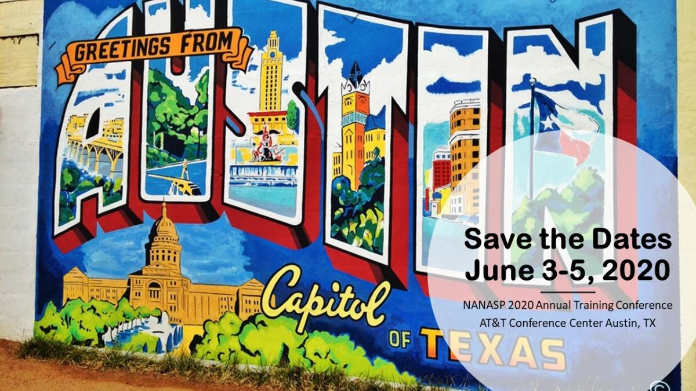

Slide 28
Resources
NANASP: http://nanasp.org
Defeat Malnutrition Today: http://defeatmalnutrition.today
NANASP Take Action: http://nanasp.org/take-action
LCAO SNAP comment letter: https://www.lcao.org/lcao-snap-comment-letter/
NANASP 2020 Conference: http://nanasp.org/NANASP2020Conference
NANASP-NRCNA grant products: http://futureofcongregate.com

